Slide 1
3 more tests by marsaglia and tsang

Slide 2
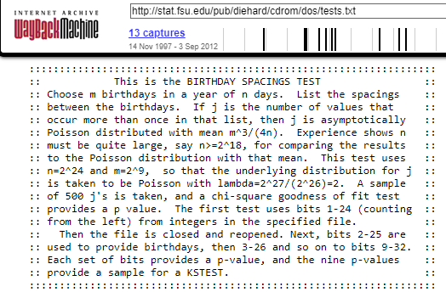
The original Diehard Battery of Tests contained only 12 tests including a test named “Birthday Spacings Test”.

Slide 3

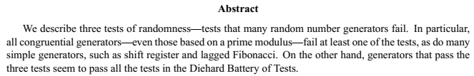
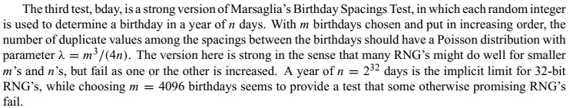

Slide 4
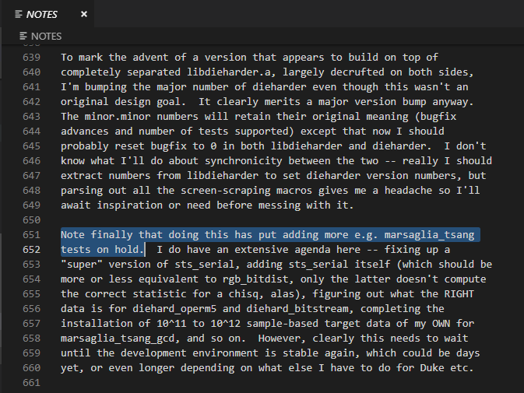
Robert G. Brown, the author of the Dieharder Battery of Tests, mentioned his plans to include these new tests back in 2006.

Slide 5
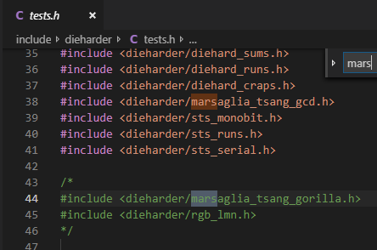
However, only the GCD test has been implemented successfully.
The gorilla test does not seem likely to be completed any time soon.

Slide 6
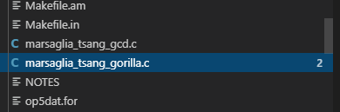
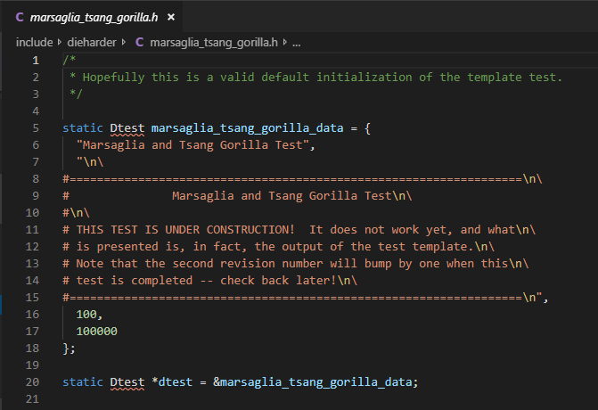

Slide 7
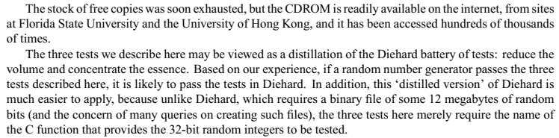
As these tests have been incorporated in newer versions of the Diehard Battery, I’ll start working on analyses of these tests.

